Slide 1

Introduction to Operating Systems CS/COE 1550
Spring 2020-2021
Sherif Khattab
ksm73@pitt.edu
(Some slides are from Silberschatz, Galvin and Gagne ©2013)

Slide 2
Announcements
Upcoming deadlines:
2/26: Project Quiz 1 and Homework 5
3/1: Lab 2
3/12: Project 2
Tophat questions due one week after each lecture
Expectations regarding help from TAs
Office hours, Piazza, incremental development
Midterm OMETs
Midterm on 3/4
2-3 days time-window to start the exam
Study spaces on campus are back open.
Paid Research Summer Work
Mascaro Center for Sustainable Innovation at the School of Engineering
Applications due 2/24

Slide 3
Last Lecture …
Using Monitors to solve Classical Process Synchronization Problems
Sleepy Barber
Deadlocks
Definition
Detecting Deadlocks

Slide 4
Muddiest Points (1/2)
Deadlock detection
How the deadlock detection algorithm applies to production code?
also, i think it's helpful to hear the real-life situations where we'd encounter all of these things
wouldn't it be a deadlock If there is any single sequence that can happen that would make them not finish?
walking through the DFS algorithm for deadlock detection
Why do OSs not take this approach to detect deadlocks
Deadlock vs Livelock
Do all 4 conditions need to be met for deadlock? Or just 1 of them?
Why are deadlocks not common?
Why in the 1st deadlock example, could a acquire s and b acquire t, but c acquiring r caused deadlock?

Slide 5
Four conditions for deadlock
Mutual exclusion
Each resource is assigned to at most one process
Hold and wait
A process holding resources can request more resources
No preemption
Previously granted resources cannot be forcibly taken away
Circular wait
There must be a circular chain of 2 or more processes where each is waiting for a resource held by the next member of the chain

Slide 6
Getting into deadlock
A
B
C
Acquire R
Acquire S
Release R
Release S
Acquire S
Acquire T
Release S
Release T
Acquire T
Acquire R
Release T
Release R
A
B
C
A
B
C
A
B
C
R
S
T
R
S
T
R
S
T
Acquire R
Acquire S
Acquire T
A
B
C
A
B
C
A
B
C
R
S
T
R
S
T
R
S
T
Deadlock!
Acquire S
Acquire T
Acquire R

Slide 7
Muddiest Points (2/2)
any hints or tips about project 2
barrier synchronization
Honestly, the project has completely taken all of my attention =(
What the main takeaways we should understand from the 3 sync problems.
Is there ever any sort of system where resources can be forcibly taken away from a process and given to another process to prevent any sort of deadlock?
Why are deadlocks not common?
What does it mean practically to “pretend there’s no problem” in the ostrich algorithm?

Slide 8
Detecting deadlocks using graphs
For each node N in the graph {
Set L = empty list
unmark all arcs
Traverse (N,L)
}
If no deadlock reported by now, there isn’t any
define Traverse (C,L) {
If C in L, report deadlock!
Add C to L
For each unmarked arc from C {
Mark the arc
Set A = arc destination
/* NOTE: L is a
local variable */
Traverse (A,L)
}
}
R
A
B
C
S
D
T
E
F
U
V
W
G
Process | Holds | Wants
A | R | S
B |  | T
C |  | S
D | U | S,T
E | T | V
F | W | S
G | V | U

Slide 9
Today’s Agenda …
Detecting Deadlocks
Avoiding Deadlocks

Slide 10


Deadlock detection algorithm
current=avail;
for (j = 0; j < N; j++) {
for (k=0; k<N; k++) {
if (finished[k])
continue;
if (want[k] <= current) {
finished[k] = 1;
current += hold[k];
break;
}
}
if (k==N) {
printf “Deadlock!\n”;
// finished[k]==0 means process is in
// the deadlock
break;
}
}
 | A | B | C | D
Avail | 2 | 3 | 0 | 1
Process | A | B | C | D
1 | 0 | 3 | 0 | 0
2 | 1 | 0 | 1 | 1
3 | 0 | 2 | 1 | 0
4 | 2 | 2 | 3 | 0
Hold
Process | A | B | C | D
1 | 3 | 2 | 1 | 0
2 | 2 | 2 | 0 | 0
3 | 3 | 5 | 3 | 1
4 | 0 | 4 | 1 | 1
Want
Note: want[j], hold[j], current, avail are arrays!

Slide 11



Deadlock detection algorithm
current=avail;
for (j = 0; j < N; j++) {
for (k=0; k<N; k++) {
if (finished[k])
continue;
if (want[k] <= current) {
finished[k] = 1;
current += hold[k];
break;
}
}
if (k==N) {
printf “Deadlock!\n”;
// finished[k]==0 means process is in
// the deadlock
break;
}
}
 | A | B | C | D
current | 2 | 3 | 0 | 1
Process | A | B | C | D
1 | 0 | 3 | 0 | 0
2 | 1 | 0 | 1 | 1
3 | 0 | 2 | 1 | 0
4 | 2 | 2 | 3 | 0
Hold
Process | A | B | C | D
1 | 3 | 2 | 1 | 0
2 | 2 | 2 | 0 | 0
3 | 3 | 5 | 3 | 1
4 | 0 | 4 | 1 | 1
Want
Note: want[j], hold[j], current, avail are arrays!

Slide 12


Deadlock detection algorithm
current=avail;
for (j = 0; j < N; j++) {
for (k=0; k<N; k++) {
if (finished[k])
continue;
if (want[k] <= current) {
finished[k] = 1;
current += hold[k];
break;
}
}
if (k==N) {
printf “Deadlock!\n”;
// finished[k]==0 means process is in
// the deadlock
break;
}
}
 | A | B | C | D
current | 2 | 3 | 0 | 1
Process | A | B | C | D
1 | 0 | 3 | 0 | 0
2 | 1 | 0 | 1 | 1
3 | 0 | 2 | 1 | 0
4 | 2 | 2 | 3 | 0
Hold
Process | A | B | C | D
1 | 3 | 2 | 1 | 0
2 | 2 | 2 | 0 | 0
3 | 3 | 5 | 3 | 1
4 | 0 | 4 | 1 | 1
Want
Note: want[j], hold[j], current, avail are arrays!

Slide 13

Deadlock detection algorithm
current=avail;
for (j = 0; j < N; j++) {
for (k=0; k<N; k++) {
if (finished[k])
continue;
if (want[k] <= current) {
finished[k] = 1;
current += hold[k];
break;
}
}
if (k==N) {
printf “Deadlock!\n”;
// finished[k]==0 means process is in
// the deadlock
break;
}
}
 | A | B | C | D
current | 3 | 3 | 1 | 2
Process | A | B | C | D
1 | 0 | 3 | 0 | 0
2 | 1 | 0 | 1 | 1
3 | 0 | 2 | 1 | 0
4 | 2 | 2 | 3 | 0
Hold
Process | A | B | C | D
1 | 3 | 2 | 1 | 0
2 | 2 | 2 | 0 | 0
3 | 3 | 5 | 3 | 1
4 | 0 | 4 | 1 | 1
Want
Note: want[j], hold[j], current, avail are arrays!

Slide 14

Deadlock detection algorithm
current=avail;
for (j = 0; j < N; j++) {
for (k=0; k<N; k++) {
if (finished[k])
continue;
if (want[k] <= current) {
finished[k] = 1;
current += hold[k];
break;
}
}
if (k==N) {
printf “Deadlock!\n”;
// finished[k]==0 means process is in
// the deadlock
break;
}
}
 | A | B | C | D
current | 3 | 3 | 1 | 2
Process | A | B | C | D
1 | 0 | 3 | 0 | 0
2 | 1 | 0 | 1 | 1
3 | 0 | 2 | 1 | 0
4 | 2 | 2 | 3 | 0
Hold
Process | A | B | C | D
1 | 3 | 2 | 1 | 0
2 | 2 | 2 | 0 | 0
3 | 3 | 5 | 3 | 1
4 | 0 | 4 | 1 | 1
Want
Note: want[j], hold[j], current, avail are arrays!

Slide 15


Deadlock detection algorithm
current=avail;
for (j = 0; j < N; j++) {
for (k=0; k<N; k++) {
if (finished[k])
continue;
if (want[k] <= current) {
finished[k] = 1;
current += hold[k];
break;
}
}
if (k==N) {
printf “Deadlock!\n”;
// finished[k]==0 means process is in
// the deadlock
break;
}
}
 | A | B | C | D
current | 3 | 3 | 1 | 2
Process | A | B | C | D
1 | 0 | 3 | 0 | 0
2 | 1 | 0 | 1 | 1
3 | 0 | 2 | 1 | 0
4 | 2 | 2 | 3 | 0
Hold
Process | A | B | C | D
1 | 3 | 2 | 1 | 0
2 | 2 | 2 | 0 | 0
3 | 3 | 5 | 3 | 1
4 | 0 | 4 | 1 | 1
Want
Note: want[j], hold[j], current, avail are arrays!

Slide 16



Deadlock detection algorithm
current=avail;
for (j = 0; j < N; j++) {
for (k=0; k<N; k++) {
if (finished[k])
continue;
if (want[k] <= current) {
finished[k] = 1;
current += hold[k];
break;
}
}
if (k==N) {
printf “Deadlock!\n”;
// finished[k]==0 means process is in
// the deadlock
break;
}
}
 | A | B | C | D
current | 3 | 3 | 1 | 2
Process | A | B | C | D
1 | 0 | 3 | 0 | 0
2 | 1 | 0 | 1 | 1
3 | 0 | 2 | 1 | 0
4 | 2 | 2 | 3 | 0
Hold
Process | A | B | C | D
1 | 3 | 2 | 1 | 0
2 | 2 | 2 | 0 | 0
3 | 3 | 5 | 3 | 1
4 | 0 | 4 | 1 | 1
Want
Note: want[j], hold[j], current, avail are arrays!

Slide 17


Deadlock detection algorithm
current=avail;
for (j = 0; j < N; j++) {
for (k=0; k<N; k++) {
if (finished[k])
continue;
if (want[k] <= current) {
finished[k] = 1;
current += hold[k];
break;
}
}
if (k==N) {
printf “Deadlock!\n”;
// finished[k]==0 means process is in
// the deadlock
break;
}
}
 | A | B | C | D
current | 3 | 6 | 1 | 2
Process | A | B | C | D
1 | 0 | 3 | 0 | 0
2 | 1 | 0 | 1 | 1
3 | 0 | 2 | 1 | 0
4 | 2 | 2 | 3 | 0
Hold
Process | A | B | C | D
1 | 3 | 2 | 1 | 0
2 | 2 | 2 | 0 | 0
3 | 3 | 5 | 3 | 1
4 | 0 | 4 | 1 | 1
Want
Note: want[j], hold[j], current, avail are arrays!

Slide 18




Deadlock detection algorithm
current=avail;
for (j = 0; j < N; j++) {
for (k=0; k<N; k++) {
if (finished[k])
continue;
if (want[k] <= current) {
finished[k] = 1;
current += hold[k];
break;
}
}
if (k==N) {
printf “Deadlock!\n”;
// finished[k]==0 means process is in
// the deadlock
break;
}
}
 | A | B | C | D
current | 3 | 6 | 1 | 2
Process | A | B | C | D
1 | 0 | 3 | 0 | 0
2 | 1 | 0 | 1 | 1
3 | 0 | 2 | 1 | 0
4 | 2 | 2 | 3 | 0
Hold
Process | A | B | C | D
1 | 3 | 2 | 1 | 0
2 | 2 | 2 | 0 | 0
3 | 3 | 5 | 3 | 1
4 | 0 | 4 | 1 | 1
Want
Note: want[j], hold[j], current, avail are arrays!

Slide 19


Deadlock detection algorithm
current=avail;
for (j = 0; j < N; j++) {
for (k=0; k<N; k++) {
if (finished[k])
continue;
if (want[k] <= current) {
finished[k] = 1;
current += hold[k];
break;
}
}
if (k==N) {
printf “Deadlock!\n”;
// finished[k]==0 means process is in
// the deadlock
break;
}
}
 | A | B | C | D
current | 5 | 8 | 4 | 2
Process | A | B | C | D
1 | 0 | 3 | 0 | 0
2 | 1 | 0 | 1 | 1
3 | 0 | 2 | 1 | 0
4 | 2 | 2 | 3 | 0
Hold
Process | A | B | C | D
1 | 3 | 2 | 1 | 0
2 | 2 | 2 | 0 | 0
3 | 3 | 5 | 3 | 1
4 | 0 | 4 | 1 | 1
Want
Note: want[j], hold[j], current, avail are arrays!

Slide 20






Deadlock detection algorithm
current=avail;
for (j = 0; j < N; j++) {
for (k=0; k<N; k++) {
if (finished[k])
continue;
if (want[k] <= current) {
finished[k] = 1;
current += hold[k];
break;
}
}
if (k==N) {
printf “Deadlock!\n”;
// finished[k]==0 means process is in
// the deadlock
break;
}
}
 | A | B | C | D
current | 5 | 8 | 4 | 2
Process | A | B | C | D
1 | 0 | 3 | 0 | 0
2 | 1 | 0 | 1 | 1
3 | 0 | 2 | 1 | 0
4 | 2 | 2 | 3 | 0
Hold
Process | A | B | C | D
1 | 3 | 2 | 1 | 0
2 | 2 | 2 | 0 | 0
3 | 3 | 5 | 3 | 1
4 | 0 | 4 | 1 | 1
Want
Note: want[j], hold[j], current, avail are arrays!

Slide 21


Deadlock detection algorithm
current=avail;
for (j = 0; j < N; j++) {
for (k=0; k<N; k++) {
if (finished[k])
continue;
if (want[k] <= current) {
finished[k] = 1;
current += hold[k];
break;
}
}
if (k==N) {
printf “Deadlock!\n”;
// finished[k]==0 means process is in
// the deadlock
break;
}
}
 | A | B | C | D
current | 5 | 10 | 5 | 2
Process | A | B | C | D
1 | 0 | 3 | 0 | 0
2 | 1 | 0 | 1 | 1
3 | 0 | 2 | 1 | 0
4 | 2 | 2 | 3 | 0
Hold
Process | A | B | C | D
1 | 3 | 2 | 1 | 0
2 | 2 | 2 | 0 | 0
3 | 3 | 5 | 3 | 1
4 | 0 | 4 | 1 | 1
Want
Note: want[j], hold[j], current, avail are arrays!

Slide 22





Deadlock detection algorithm
current=avail;
for (j = 0; j < N; j++) {
for (k=0; k<N; k++) {
if (finished[k])
continue;
if (want[k] <= current) {
finished[k] = 1;
current += hold[k];
break;
}
}
if (k==N) {
printf “Deadlock!\n”;
// finished[k]==0 means process is in
// the deadlock
break;
}
}
 | A | B | C | D
current | 5 | 10 | 5 | 2
Process | A | B | C | D
1 | 0 | 3 | 0 | 0
2 | 1 | 0 | 1 | 1
3 | 0 | 2 | 1 | 0
4 | 2 | 2 | 3 | 0
Hold
Process | A | B | C | D
1 | 3 | 2 | 1 | 0
2 | 2 | 2 | 0 | 0
3 | 3 | 5 | 3 | 1
4 | 0 | 4 | 1 | 1
Want
Note: want[j], hold[j], current, avail are arrays!

Slide 23
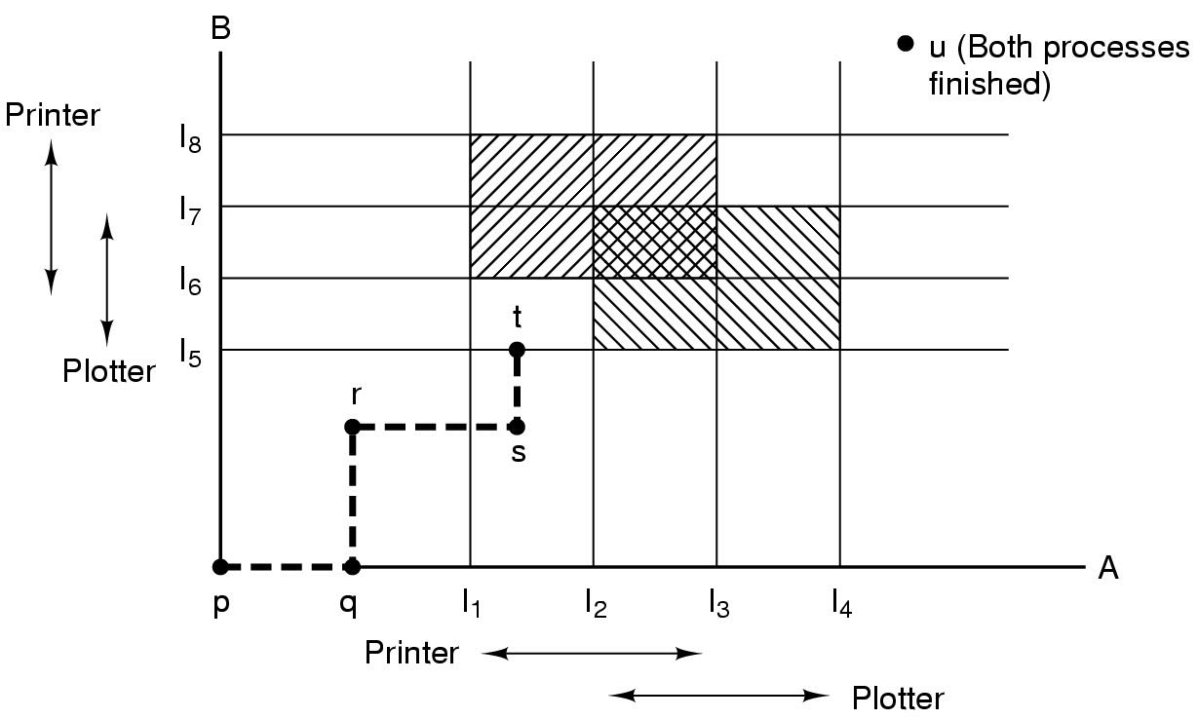
Resource trajectories
Two process resource trajectories

Slide 24

Resource trajectories
Two process resource trajectories

Slide 25


Resource trajectories
Two process resource trajectories

Slide 26



Resource trajectories
Two process resource trajectories

Slide 27

Resource trajectories
Two process resource trajectories

Slide 28

Resource trajectories
Two process resource trajectories

Slide 29

Resource trajectories
Two process resource trajectories

Slide 30

Resource trajectories
Two process resource trajectories

Slide 31

Resource trajectories
Two process resource trajectories

Slide 32
Safe and unsafe states
 | Has | Max
A | 3 | 9
B | 2 | 4
C | 2 | 7
Free: 3
 | Has | Max
A | 3 | 9
B | 4 | 4
C | 2 | 7
Free: 1
 | Has | Max
A | 3 | 9
B | 0 | -
C | 2 | 7
Free: 5
 | Has | Max
A | 3 | 9
B | 0 | -
C | 7 | 7
Free: 0
 | Has | Max
A | 3 | 9
B | 0 | -
C | 0 | -
Free: 7
Demonstration that the first state is safe
 | Has | Max
A | 3 | 9
B | 2 | 4
C | 2 | 7
Free: 3
 | Has | Max
A | 4 | 9
B | 2 | 4
C | 2 | 7
Free: 2
 | Has | Max
A | 4 | 9
B | 4 | 4
C | 2 | 7
Free: 0
 | Has | Max
A | 4 | 9
B | 0 | -
C | 2 | 7
Free: 4
Demonstration that the second state is unsafe

Slide 33
Banker's Algorithm for a single resource
Bankers’ algorithm: before granting a request, ensure that a sequence exists that will allow all processes to complete
Use previous methods to find such a sequence
If a sequence exists, allow the requests
If there’s no such sequence, deny the request
Can be slow: must be done on each request!
 | Has | Max
A | 0 | 6
B | 0 | 5
C | 0 | 4
D | 0 | 7
Free: 10

Slide 34
Banker's Algorithm for a single resource
Bankers’ algorithm: before granting a request, ensure that a sequence exists that will allow all processes to complete
Use previous methods to find such a sequence
If a sequence exists, allow the requests
If there’s no such sequence, deny the request
Can be slow: must be done on each request!
 | Has | Max
A | 0 | 6
B | 0 | 5
C | 0 | 4
D | 0 | 7
Free: 10
 | Has | Max
A | 1 | 6
B | 1 | 5
C | 2 | 4
D | 4 | 7
Free: 2
Any sequence finishes

Slide 35
Banker's Algorithm for a single resource
Bankers’ algorithm: before granting a request, ensure that a sequence exists that will allow all processes to complete
Use previous methods to find such a sequence
If a sequence exists, allow the requests
If there’s no such sequence, deny the request
Can be slow: must be done on each request!
 | Has | Max
A | 0 | 6
B | 0 | 5
C | 0 | 4
D | 0 | 7
Free: 10
 | Has | Max
A | 1 | 6
B | 1 | 5
C | 2 | 4
D | 4 | 7
Free: 2
 | Has | Max
A | 1 | 6
B | 2 | 5
C | 2 | 4
D | 4 | 7
Free: 1
Any sequence finishes
C,B,A,D finishes

Slide 36
Banker's Algorithm for a single resource
Bankers’ algorithm: before granting a request, ensure that a sequence exists that will allow all processes to complete
Use previous methods to find such a sequence
If a sequence exists, allow the requests
If there’s no such sequence, deny the request
Can be slow: must be done on each request!
 | Has | Max
A | 0 | 6
B | 0 | 5
C | 0 | 4
D | 0 | 7
Free: 10
 | Has | Max
A | 1 | 6
B | 1 | 5
C | 2 | 4
D | 4 | 7
Free: 2
 | Has | Max
A | 1 | 6
B | 2 | 5
C | 2 | 4
D | 4 | 7
Free: 1
Any sequence finishes
C,B,A,D finishes
Deadlock (unsafe state)

Slide 37
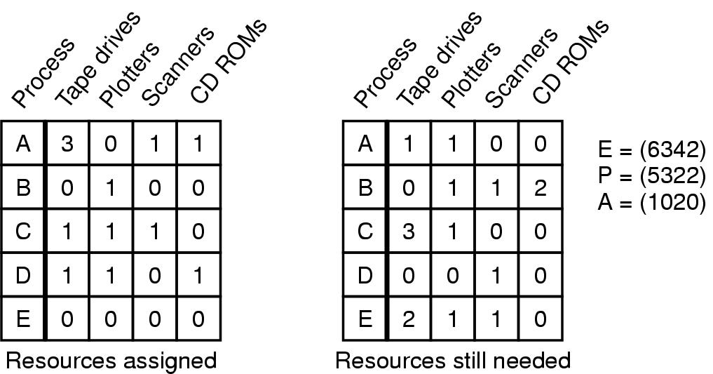
Banker's Algorithm for multiple resources
Example of banker's algorithm with multiple resources

